Slide 1
CSE419 – Artificial Intelligence and Machine Learning 2021 PhD Furkan Gözükara, Toros University https://github.com/FurkanGozukara/CSE419-Artificial-Intelligence-and-Machine-Learning-2020
Lecture 2 – Part 2
Decision Trees
Based on Asst. Prof. Dr. David Kauchak (Pomona College) Lecture Slides
Source: https://cs.pomona.edu/~dkauchak/classes/f13/cs451-f13/lectures/

Slide 2

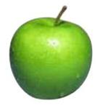


Representing examples
examples
What is an example?
How is it represented?

Slide 3
Features
examples
features
How our algorithms actually “view” the data
Features are the questions we can ask about the examples
f₁, f₂, f₃, …, f_{n}
f₁, f₂, f₃, …, f_{n}
f₁, f₂, f₃, …, f_{n}
f₁, f₂, f₃, …, f_{n}

Slide 4
Features
examples
features
How our algorithms actually “view” the data
Features are the questions we can ask about the examples
red, round, leaf, 3oz, …
green, round, no leaf, 4oz, …
yellow, curved, no leaf, 4oz, …
green, curved, no leaf, 5oz, …

Slide 5
Classification revisited
examples
label
red, round, leaf, 3oz, …
apple
learn
green, round, no leaf, 4oz, …
apple
model/
classifier
yellow, curved, no leaf, 4oz, …
banana
green, curved, no leaf, 5oz, …
banana
During learning/training/induction, learn a model of what distinguishes apples and bananas based on the features

Slide 6
Classification revisited
predict
Apple or banana?
model/
classifier
red, round, no leaf, 4oz, …
The model can then classify a new example based on the features

Slide 7
Classification revisited
predict
model/
classifier
Apple
red, round, no leaf, 4oz, …
Why?
The model can then classify a new example based on the features

Slide 8
Classification revisited
Training data
Test set
examples
label
red, round, leaf, 3oz, …
apple
?
green, round, no leaf, 4oz, …
apple
red, round, no leaf, 4oz, …
yellow, curved, no leaf, 4oz, …
banana
green, curved, no leaf, 5oz, …
banana

Slide 9
Classification revisited
Training data
Test set
examples
label
red, round, leaf, 3oz, …
apple
?
green, round, no leaf, 4oz, …
apple
red, round, no leaf, 4oz, …
Learning is about generalizing from the training data
yellow, curved, no leaf, 4oz, …
banana
green, curved, no leaf, 5oz, …
banana
What does this assume about the training and test set?

Slide 10
Past predicts future
Training data
Test set

Slide 11

Past predicts future
Training data
Test set
Not always the case, but we’ll often assume it is!

Slide 12
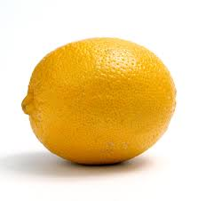
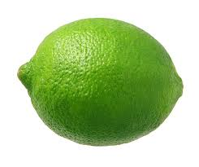
Past predicts future
Training data
Test set
Not always the case, but we’ll often assume it is!

Slide 13
More technically…
We are going to use the probabilistic model of learning
There is some probability distribution over example/label pairs called the data generating distribution
Both the training data and the test set are generated based on this distribution
What is a probability distribution?

Slide 14
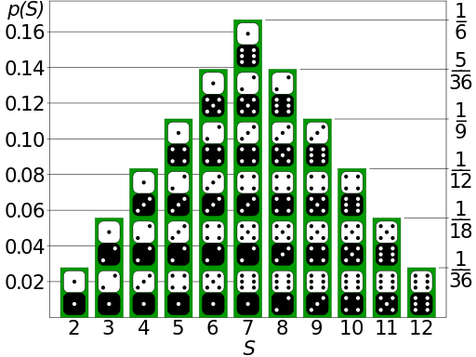
Probability distribution
Describes how likely (i.e. probable) certain events are

Slide 15
Probability distribution
Training data
High probability
Low probability
round apples
curved bananas
apples with leaves
…
curved apples
red bananas
yellow apples
…

Slide 16
data generating distribution
Training data
Test set
data generating distribution

Slide 17
data generating distribution
Training data
Test set
data generating distribution

Slide 18
data generating distribution
Training data
Test set
data generating distribution

Slide 19
To ride or not to ride, that is the question…
Terrain | Unicycle-type | Weather | Go-For-Ride?
Trail | Normal | Rainy | NO
Road | Normal | Sunny | YES
Trail | Mountain | Sunny | YES
Road | Mountain | Rainy | YES
Trail | Normal | Snowy | NO
Road | Normal | Rainy | YES
Road | Mountain | Snowy | YES
Trail | Normal | Sunny | NO
Road | Normal | Snowy | NO
Trail | Mountain | Snowy | YES
Build a decision tree

Slide 20
Recursive approach
Base case: If all data belong to the same class, create a leaf node with that label
Otherwise:
calculate the “score” for each feature if we used it to split the data
pick the feature with the highest score, partition the data based on that data value and call recursively

Slide 21
Partitioning the data
Terrain
Terrain | Unicycle-type | Weather | Go-For-Ride?
Trail | Normal | Rainy | NO
Road | Normal | Sunny | YES
Trail | Mountain | Sunny | YES
Road | Mountain | Rainy | YES
Trail | Normal | Snowy | NO
Road | Normal | Rainy | YES
Road | Mountain | Snowy | YES
Trail | Normal | Sunny | NO
Road | Normal | Snowy | NO
Trail | Mountain | Snowy | YES
Road
Trail
YES: 4
NO: 1
YES: 2
NO: 3
Unicycle
Mountain
Normal
YES: 4
NO: 0
YES: 2
NO: 4
Weather
Rainy
Snowy
Sunny
YES: 2
NO: 1
YES: 2
NO: 2
YES: 2
NO: 1

Slide 22
Partitioning the data
Terrain
Unicycle
Weather
Road
Trail
Mountain
Normal
Rainy
Snowy
Sunny
YES: 4
NO: 1
YES: 2
NO: 3
YES: 4
NO: 0
YES: 2
NO: 4
YES: 2
NO: 1
YES: 2
NO: 2
YES: 2
NO: 1
calculate the “score” for each feature if we used it to split the data
What score should we use?
If we just stopped here, which tree would be best? How could we make these into decision trees?

Slide 23
Decision trees
Terrain
Unicycle
Weather
Road
Trail
Mountain
Normal
Rainy
Snowy
Sunny
YES: 4
NO: 1
YES: 2
NO: 3
YES: 4
NO: 0
YES: 2
NO: 4
YES: 2
NO: 1
YES: 2
NO: 2
YES: 2
NO: 1
How could we make these into decision trees?

Slide 24
Decision trees
Terrain
Unicycle
Weather
Road
Trail
Mountain
Normal
Rainy
Snowy
Sunny
YES: 4
NO: 1
YES: 2
NO: 3
YES: 4
NO: 0
YES: 2
NO: 4
YES: 2
NO: 1
YES: 2
NO: 2
YES: 2
NO: 1

Slide 25
Decision trees
Terrain
Unicycle
Weather
Road
Trail
Mountain
Normal
Rainy
Snowy
Sunny
YES: 4
NO: 1
YES: 2
NO: 3
YES: 4
NO: 0
YES: 2
NO: 4
YES: 2
NO: 1
YES: 2
NO: 2
YES: 2
NO: 1
Training error: the average error over the training set
For classification, the most common “error” is the number of mistakes
Training error for each of these?

Slide 26
Decision trees
Terrain
Unicycle
Weather
Road
Trail
Mountain
Normal
Rainy
Snowy
Sunny
YES: 4
NO: 1
YES: 2
NO: 3
YES: 4
NO: 0
YES: 2
NO: 4
YES: 2
NO: 1
YES: 2
NO: 2
YES: 2
NO: 1
3/10
2/10
4/10
Training error: the average error over the training set

Slide 27
Recurse
Unicycle
Mountain
Normal
YES: 4
NO: 0
YES: 2
NO: 4
Terrain | Unicycle-type | Weather | Go-For-Ride?
Trail | Mountain | Sunny | YES
Road | Mountain | Rainy | YES
Road | Mountain | Snowy | YES
Trail | Mountain | Snowy | YES
Terrain | Unicycle-type | Weather | Go-For-Ride?
Trail | Normal | Rainy | NO
Road | Normal | Sunny | YES
Trail | Normal | Snowy | NO
Road | Normal | Rainy | YES
Trail | Normal | Sunny | NO
Road | Normal | Snowy | NO

Slide 28
Recurse
Terrain
Unicycle
Road
Trail
Mountain
Normal
YES: 2
NO: 1
YES: 0
NO: 3
YES: 4
NO: 0
YES: 2
NO: 4
Terrain | Unicycle-type | Weather | Go-For-Ride?
Trail | Normal | Rainy | NO
Road | Normal | Sunny | YES
Trail | Normal | Snowy | NO
Road | Normal | Rainy | YES
Trail | Normal | Sunny | NO
Road | Normal | Snowy | NO
Weather
Rainy
Snowy
Sunny
YES: 1
NO: 1
YES: 0
NO: 2
YES: 1
NO: 1

Slide 29
Recurse
Terrain
Unicycle
Road
Trail
Mountain
Normal
YES: 2
NO: 1
YES: 0
NO: 3
YES: 4
NO: 0
YES: 2
NO: 4
1/6
Terrain | Unicycle-type | Weather | Go-For-Ride?
Trail | Normal | Rainy | NO
Road | Normal | Sunny | YES
Trail | Normal | Snowy | NO
Road | Normal | Rainy | YES
Trail | Normal | Sunny | NO
Road | Normal | Snowy | NO
Weather
Rainy
Snowy
Sunny
YES: 1
NO: 1
YES: 0
NO: 2
YES: 1
NO: 1
2/6

Slide 30
Recurse
Unicycle
Mountain
Normal
YES: 4
NO: 0
Terrain
Road
Trail
YES: 2
NO: 1
YES: 0
NO: 3
Terrain | Unicycle-type | Weather | Go-For-Ride?
Road | Normal | Sunny | YES
Road | Normal | Rainy | YES
Road | Normal | Snowy | NO

Slide 31
Recurse
Unicycle
Terrain | Unicycle-type | Weather | Go-For-Ride?
Trail | Normal | Rainy | NO
Road | Normal | Sunny | YES
Trail | Mountain | Sunny | YES
Road | Mountain | Rainy | YES
Trail | Normal | Snowy | NO
Road | Normal | Rainy | YES
Road | Mountain | Snowy | YES
Trail | Normal | Sunny | NO
Road | Normal | Snowy | NO
Trail | Mountain | Snowy | YES
Trail | Mountain | Rainy | ???
Road | Mountain | Sunny | ???
Mountain
Normal
YES: 4
NO: 0
Terrain
Road
Trail
Weather
YES: 0
NO: 3
Rainy
Snowy
Sunny
YES: 1
NO: 1
YES: 0
NO: 1
YES: 1
NO: 0

Slide 32
Building decision trees
Base case: If all data belong to the same class, create a leaf node with that label
Otherwise:
calculate the “score” for each feature if we used it to split the data
pick the feature with the highest score, partition the data based on that data value and call recursively

Slide 33
Partitioning the data
Terrain
Terrain | Unicycle-type | Weather | Go-For-Ride?
Trail | Normal | Rainy | NO
Road | Normal | Sunny | YES
Trail | Mountain | Sunny | YES
Road | Mountain | Rainy | YES
Trail | Normal | Snowy | NO
Road | Normal | Rainy | YES
Road | Mountain | Snowy | YES
Trail | Normal | Sunny | NO
Road | Normal | Snowy | NO
Trail | Mountain | Snowy | YES
Road
Trail
YES: 4
NO: 1
YES: 2
NO: 3
Unicycle
Mountain
Normal
YES: 4
NO: 0
YES: 2
NO: 4
Weather
Rainy
Snowy
Sunny
YES: 2
NO: 1
YES: 2
NO: 2
YES: 2
NO: 1

Slide 34
Decision trees
Terrain
Unicycle
Weather
Road
Trail
Mountain
Normal
Rainy
Snowy
Sunny
YES: 4
NO: 1
YES: 2
NO: 3
YES: 4
NO: 0
YES: 2
NO: 4
YES: 2
NO: 1
YES: 2
NO: 2
YES: 2
NO: 1
3/10
2/10
4/10
Training error: the average error over the training set

Slide 35
Training error vs. accuracy
Terrain
Unicycle
Weather
Road
Trail
Mountain
Normal
Rainy
Snowy
Sunny
YES: 4
NO: 1
YES: 2
NO: 3
YES: 4
NO: 0
YES: 2
NO: 4
YES: 2
NO: 1
YES: 2
NO: 2
YES: 2
NO: 1
Training
error:
3/10
2/10
4/10
Training
accuracy:
7/10
8/10
6/10
training error = 1-accuracy (and vice versa)
Training error: the average error over the training set
Training accuracy: the average percent correct over the training set

Slide 36
Recurse
Unicycle
Mountain
Normal
YES: 4
NO: 0
YES: 2
NO: 4
Terrain | Unicycle-type | Weather | Go-For-Ride?
Trail | Mountain | Sunny | YES
Road | Mountain | Rainy | YES
Road | Mountain | Snowy | YES
Trail | Mountain | Snowy | YES
Terrain | Unicycle-type | Weather | Go-For-Ride?
Trail | Normal | Rainy | NO
Road | Normal | Sunny | YES
Trail | Normal | Snowy | NO
Road | Normal | Rainy | YES
Trail | Normal | Sunny | NO
Road | Normal | Snowy | NO

Slide 37
Recurse
Terrain
Unicycle
Road
Trail
Mountain
Normal
YES: 2
NO: 1
YES: 0
NO: 3
YES: 4
NO: 0
YES: 2
NO: 4
Terrain | Unicycle-type | Weather | Go-For-Ride?
Trail | Normal | Rainy | NO
Road | Normal | Sunny | YES
Trail | Normal | Snowy | NO
Road | Normal | Rainy | YES
Trail | Normal | Sunny | NO
Road | Normal | Snowy | NO
Weather
Rainy
Snowy
Sunny
YES: 1
NO: 1
YES: 0
NO: 2
YES: 1
NO: 1

Slide 38
Recurse
Terrain
Unicycle
Road
Trail
Mountain
Normal
YES: 2
NO: 1
YES: 0
NO: 3
YES: 4
NO: 0
YES: 2
NO: 4
1/6
Terrain | Unicycle-type | Weather | Go-For-Ride?
Trail | Normal | Rainy | NO
Road | Normal | Sunny | YES
Trail | Normal | Snowy | NO
Road | Normal | Rainy | YES
Trail | Normal | Sunny | NO
Road | Normal | Snowy | NO
Weather
Rainy
Snowy
Sunny
YES: 1
NO: 1
YES: 0
NO: 2
YES: 1
NO: 1
2/6

Slide 39
Recurse
Unicycle
Mountain
Normal
YES: 4
NO: 0
Terrain
Road
Trail
YES: 2
NO: 1
YES: 0
NO: 3
Terrain | Unicycle-type | Weather | Go-For-Ride?
Road | Normal | Sunny | YES
Road | Normal | Rainy | YES
Road | Normal | Snowy | NO

Slide 40
Recurse
Unicycle
Mountain
Normal
YES: 4
NO: 0
Terrain
Road
Trail
Weather
YES: 0
NO: 3
Rainy
Snowy
Sunny
YES: 1
NO: 0
YES: 0
NO: 1
YES: 1
NO: 0

Slide 41
Recurse
Unicycle
Terrain | Unicycle-type | Weather | Go-For-Ride?
Trail | Normal | Rainy | NO
Road | Normal | Sunny | YES
Trail | Mountain | Sunny | YES
Road | Mountain | Rainy | YES
Trail | Normal | Snowy | NO
Road | Normal | Rainy | YES
Road | Mountain | Snowy | YES
Trail | Normal | Sunny | NO
Road | Normal | Snowy | NO
Trail | Mountain | Snowy | YES
Mountain
Normal
YES: 4
NO: 0
Terrain
Road
Trail
Weather
YES: 0
NO: 3
Rainy
Snowy
Sunny
YES: 1
NO: 0
YES: 0
NO: 1
YES: 1
NO: 0
Are we always guaranteed to get a training error of 0?
Training error?

Slide 42
Problematic data
Terrain | Unicycle-type | Weather | Go-For-Ride?
Trail | Normal | Rainy | NO
Road | Normal | Sunny | YES
Trail | Mountain | Sunny | YES
Road | Mountain | Snowy | NO
Trail | Normal | Snowy | NO
Road | Normal | Rainy | YES
Road | Mountain | Snowy | YES
Trail | Normal | Sunny | NO
Road | Normal | Snowy | NO
Trail | Mountain | Snowy | YES
When can this happen?
Notes:
Error/noise in the data
Missing discriminating preference, e.g. maybe we also need to know whether the person has a good jacket or not.

Slide 43
Recursive approach
Base case: If all data belong to the same class, create a leaf node with that label OR all the data has the same feature values
Do we always want to go all the way to the bottom?

Slide 44
What would the tree look like for…
Terrain | Unicycle-type | Weather | Go-For-Ride?
Trail | Mountain | Rainy | YES
Trail | Mountain | Sunny | YES
Road | Mountain | Snowy | YES
Road | Mountain | Sunny | YES
Trail | Normal | Snowy | NO
Trail | Normal | Rainy | NO
Road | Normal | Snowy | YES
Road | Normal | Sunny | NO
Trail | Normal | Sunny | NO

Slide 45
What would the tree look like for…
Unicycle
Terrain | Unicycle-type | Weather | Go-For-Ride?
Trail | Mountain | Rainy | YES
Trail | Mountain | Sunny | YES
Road | Mountain | Snowy | YES
Road | Mountain | Sunny | YES
Trail | Normal | Snowy | NO
Trail | Normal | Rainy | NO
Road | Normal | Snowy | YES
Road | Normal | Sunny | NO
Trail | Normal | Sunny | NO
Mountain
Normal
YES
Terrain
Road
Trail
Weather
NO
Rainy
Snowy
Sunny
NO
YES
NO
Is that what you would do?
Notes:
- an aside, how did we decide to pick the label for normal->road->rainy? There were no examples in the training data set.

Slide 46
What would the tree look like for…
Unicycle
Terrain | Unicycle-type | Weather | Go-For-Ride?
Trail | Mountain | Rainy | YES
Trail | Mountain | Sunny | YES
Road | Mountain | Snowy | YES
Road | Mountain | Sunny | YES
Trail | Normal | Snowy | NO
Trail | Normal | Rainy | NO
Road | Normal | Snowy | YES
Road | Normal | Sunny | NO
Trail | Normal | Sunny | NO
Mountain
Normal
YES
Terrain
Road
Trail
Weather
NO
Rainy
Snowy
Sunny
NO
YES
NO
Maybe…
Unicycle
Mountain
Normal
YES
NO

Slide 47
What would the tree look like for…
Terrain | Unicycle-type | Weather | Jacket | ML grade | Go-For-Ride?
Trail | Mountain | Rainy | Heavy | D | YES
Trail | Mountain | Sunny | Light | C- | YES
Road | Mountain | Snowy | Light | B | YES
Road | Mountain | Sunny | Heavy | A | YES
… | Mountain | … | … | … | YES
Trail | Normal | Snowy | Light | D+ | NO
Trail | Normal | Rainy | Heavy | B- | NO
Road | Normal | Snowy | Heavy | C+ | YES
Road | Normal | Sunny | Light | A- | NO
Trail | Normal | Sunny | Heavy | B+ | NO
Trail | Normal | Snowy | Light | F | NO
… | Normal | … | … | … | NO
Trail | Normal | Rainy | Light | C | YES

Slide 48
Overfitting
Terrain | Unicycle-type | Weather | Go-For-Ride?
Trail | Mountain | Rainy | YES
Trail | Mountain | Sunny | YES
Road | Mountain | Snowy | YES
Road | Mountain | Sunny | YES
Trail | Normal | Snowy | NO
Trail | Normal | Rainy | NO
Road | Normal | Snowy | YES
Road | Normal | Sunny | NO
Trail | Normal | Sunny | NO
Unicycle
Mountain
Normal
YES
NO
Overfitting occurs when we bias our model too much towards the training data
Our goal is to learn a general model that will work on the training data as well as other data (i.e. test data)

Slide 49
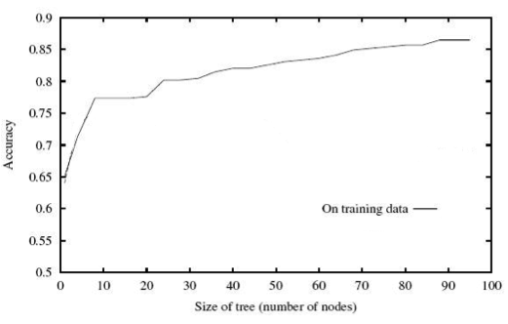
Overfitting
Our decision tree learning procedure always decreases training error
Is that what we want?

Slide 50
Test set error!
Machine learning is about predicting the future based on the past.
-- Hal Daume III
past
future
predict
learn
Training
Data
model/
predictor
Testing
Data
model/
predictor

Slide 51
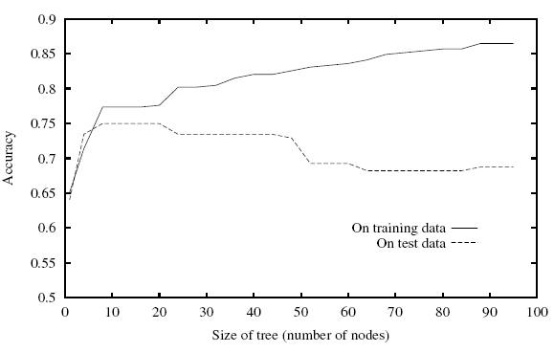
Overfitting
Even though the training error is decreasing, the testing error can go up!

Slide 52
Overfitting
Unicycle
Terrain | Unicycle-type | Weather | Go-For-Ride?
Trail | Mountain | Rainy | YES
Trail | Mountain | Sunny | YES
Road | Mountain | Snowy | YES
Road | Mountain | Sunny | YES
Trail | Normal | Snowy | NO
Trail | Normal | Rainy | NO
Road | Normal | Snowy | YES
Road | Normal | Sunny | NO
Trail | Normal | Sunny | NO
Mountain
Normal
YES
Terrain
Road
Trail
Weather
NO
Rainy
Snowy
Sunny
NO
YES
NO
How do we prevent overfitting?

Slide 53
Preventing overfitting
Base case: If all data belong to the same class, create a leaf node with that label OR all the data has the same feature values OR
We’ve reached a particular depth in the tree
?
One idea: stop building the tree early

Slide 54
Preventing overfitting
Base case: If all data belong to the same class, create a leaf node with that label OR all the data has the same feature values OR
We’ve reached a particular depth in the tree
We only have a certain number/fraction of examples remaining
We’ve reached a particular training error
Use development data (more on this later)
…

Slide 55
Preventing overfitting: pruning
Unicycle
Pruning: after the tree is built, go back and “prune” the tree, i.e. remove some lower parts of the tree
Similar to stopping early, but done after the entire tree is built
Mountain
Normal
YES
Terrain
Road
Trail
Weather
NO
Rainy
Snowy
Sunny
NO
YES
NO

Slide 56
Preventing overfitting: pruning
Unicycle
Mountain
Normal
YES
Terrain
Road
Trail
Weather
NO
Rainy
Snowy
Sunny
NO
YES
NO
Build the full tree

Slide 57
Preventing overfitting: pruning
Unicycle
Mountain
Normal
YES
Terrain
Unicycle
Road
Trail
Mountain
Normal
Weather
NO
YES
NO
Rainy
Snowy
Sunny
NO
YES
NO
Build the full tree
Prune back leaves that are too specific

Slide 58
Preventing overfitting: pruning
Unicycle
Mountain
Normal
YES
Terrain
Unicycle
Road
Trail
Mountain
Normal
Weather
NO
YES
NO
Rainy
Snowy
Sunny
NO
YES
NO
Pruning criterion?
Notes:
- many of the same things we used to “pre-prune”, i.e. stop building early

Slide 59
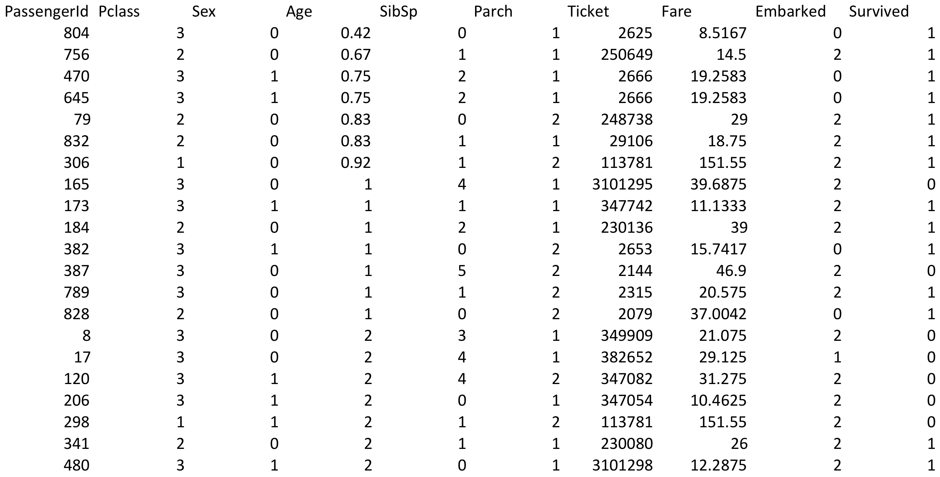
Handling non-binary attributes
What do we do with features that have multiple values? Real-values?

Slide 60
Features with multiple values
Rainy?
Rainy
not Rainy
Weather
NO
Snowy?
Rainy
Snowy
Sunny
Snowy
Sunny
NO
YES
NO
YES
NO
Treat as an n-ary split
Treat as multiple binary splits

Slide 61
Real-valued features
Use any comparison test (>, <, ≤, ≥) to split the data into two parts
Select a range filter, i.e. min < value < max
Fare < $20
Fare
Yes
No
0-10
>50
10-20
20-50

Slide 62
Other splitting criterion
Otherwise:
calculate the “score” for each feature if we used it to split the data
pick the feature with the highest score, partition the data based on that data value and call recursively
We used training error for the score. Any other ideas?

Slide 63
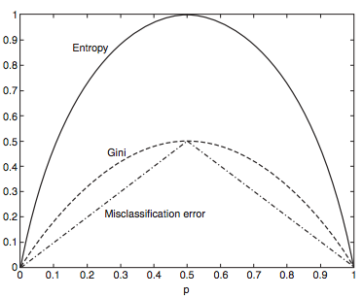
Other splitting criterion
- Entropy: how much uncertainty there is in the distribution over labels after the split
- Gini: sum of the square of the label proportions after split
- Training error = misclassification error
Notes:
All tend to perform roughly the same, so we often won’t worry too much about this

Slide 64
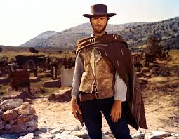
Decision trees
Good? Bad?

Slide 65
Decision trees: the good
Very intuitive and easy to interpret
Fast to run and fairly easy to implement
Historically, perform fairly well (especially with a few more tricks we’ll see later on)
No prior assumptions about the data

Slide 66
Decision trees: the bad
Be careful with features with lots of values
ID | Terrain | Unicycle-type | Weather | Go-For-Ride?
1 | Trail | Normal | Rainy | NO
2 | Road | Normal | Sunny | YES
3 | Trail | Mountain | Sunny | YES
4 | Road | Mountain | Rainy | YES
5 | Trail | Normal | Snowy | NO
6 | Road | Normal | Rainy | YES
7 | Road | Mountain | Snowy | YES
8 | Trail | Normal | Sunny | NO
9 | Road | Normal | Snowy | NO
10 | Trail | Mountain | Snowy | YES
Which feature would be at the top here?
Notes:
- this is also why many decision tree learning algorithms always use binary splits

Slide 67
Decision trees: the bad
Can be problematic (slow, bad performance) with large numbers of features
Can’t learn some very simple data sets (e.g. some types of linearly separable data)
Pruning/tuning can be tricky to get right

Slide 68
Final DT algorithm
Base cases:
If all data belong to the same class, pick that label
If all the data have the same feature values, pick majority label
If we’re out of features to examine, pick majority label
If the we don’t have any data left, pick majority label of parent
If some other stopping criteria exists to avoid overfitting, pick majority label
Otherwise:
calculate the “score” for each feature if we used it to split the data
pick the feature with the highest score, partition the data based on that data value and call recursively

Slide 69
Alternative Score Calculation – Information Gain
Why information gain is better over accuracy?
Decision trees are generally prone to over-fitting and accuracy doesn't generalize well to unseen data.
One advantage of information gain is that -- due to the factor −p∗log(p) in the entropy definition -- leafs with a small number of instances are assigned less weight (limp→0+p∗log(p)=0) and it favors dividing data into bigger but homogeneous groups.
This approach is usually more stable and also chooses the most impactful features close to the root of the tree.

Slide 70
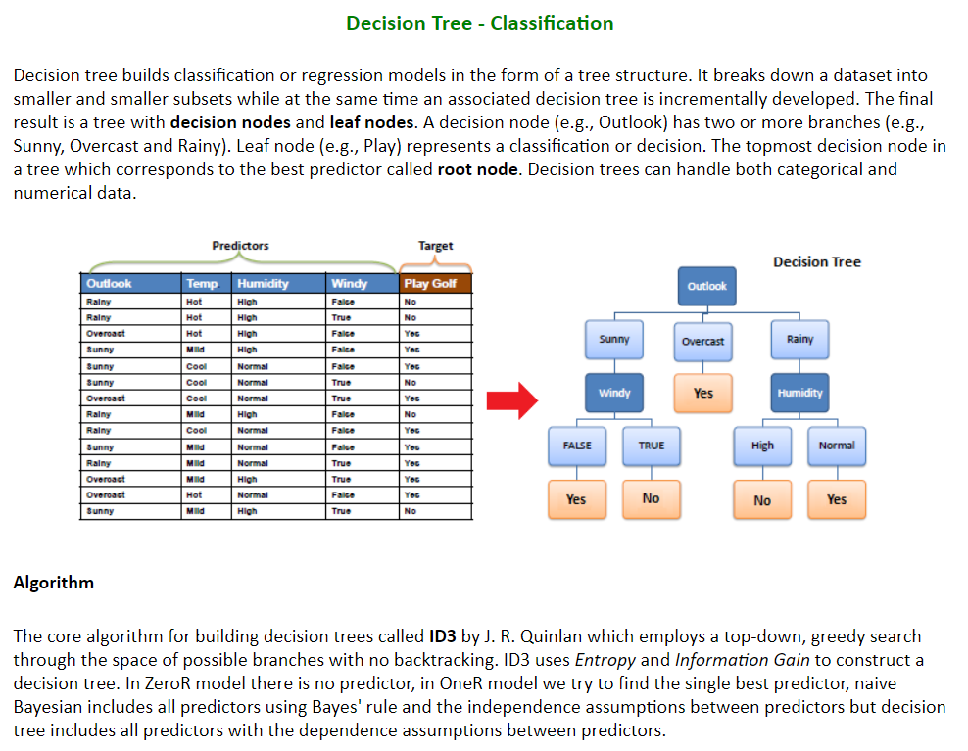

Slide 71
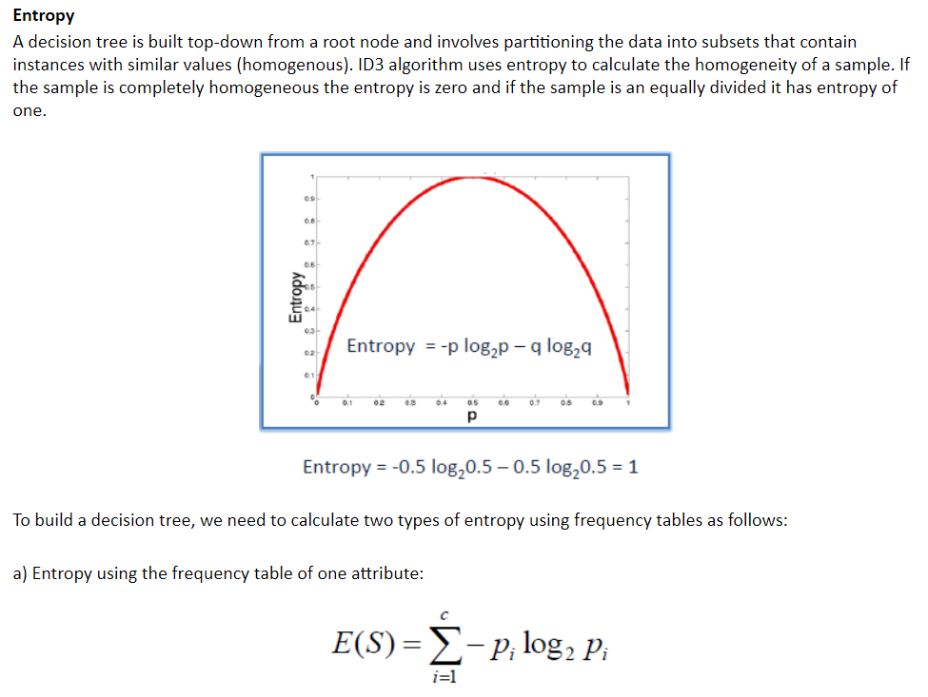

Slide 72
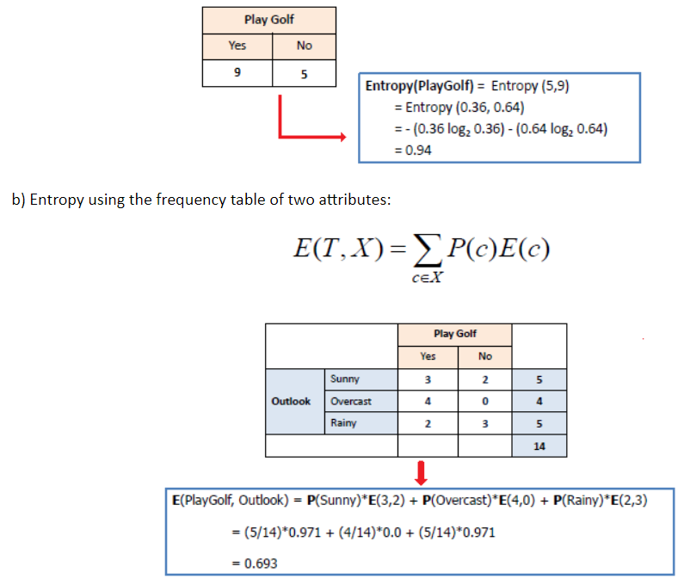

Slide 73
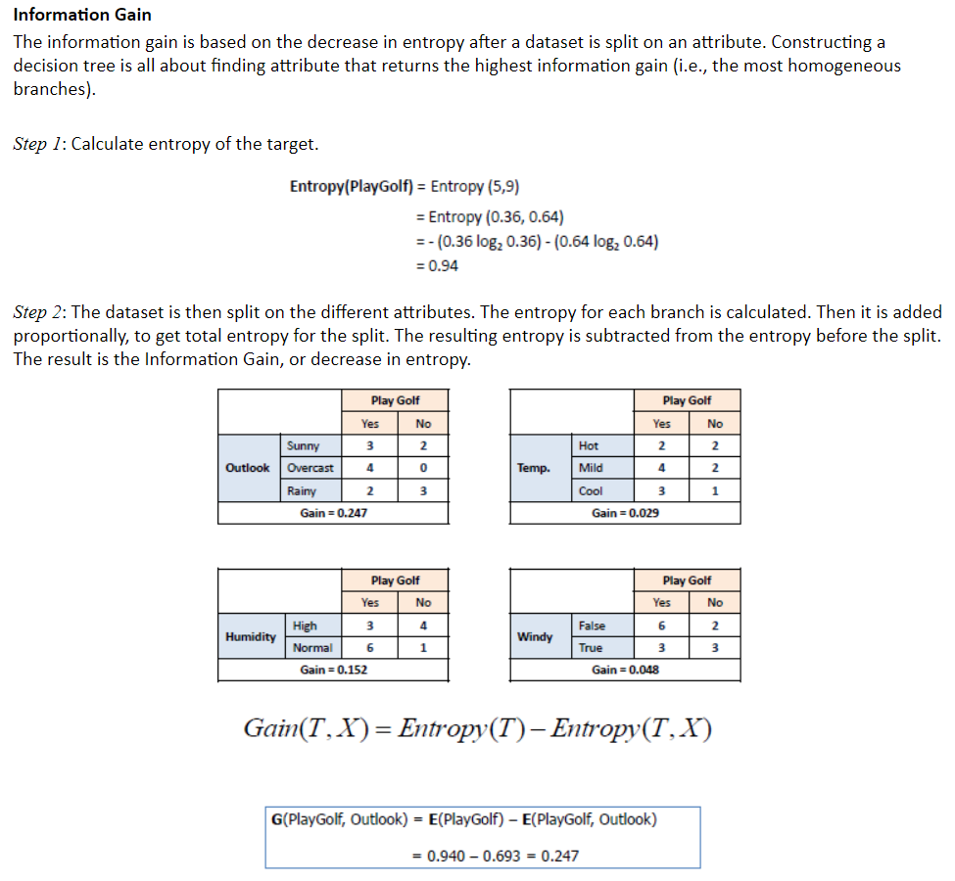

Slide 74
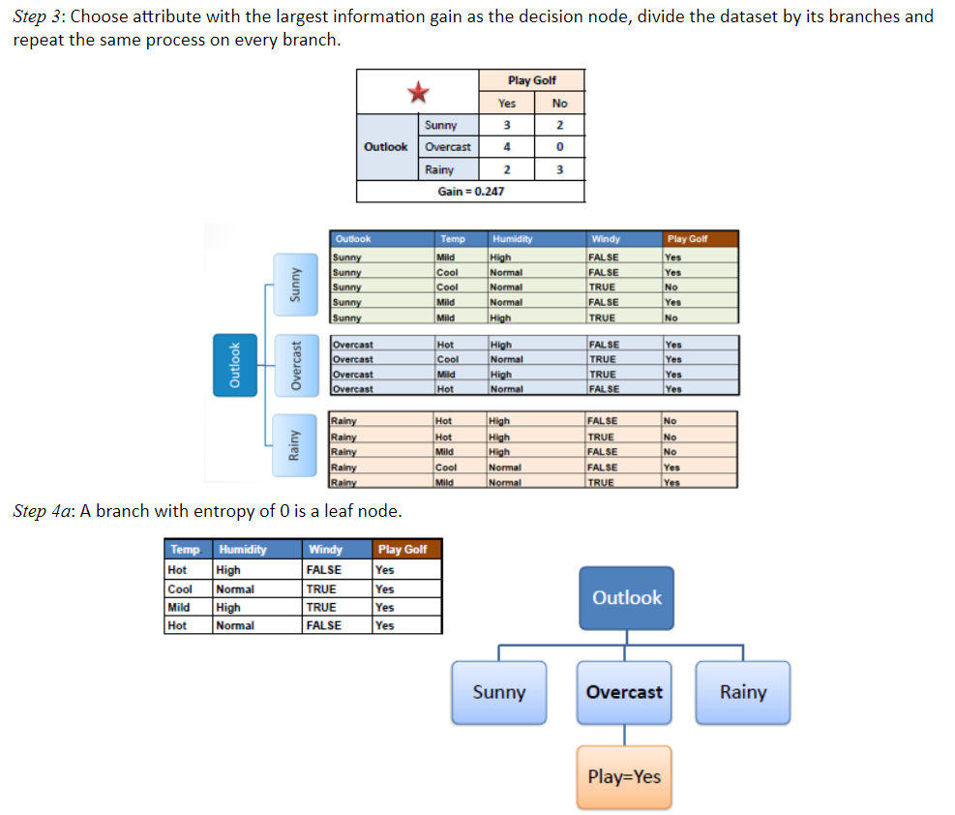

Slide 75
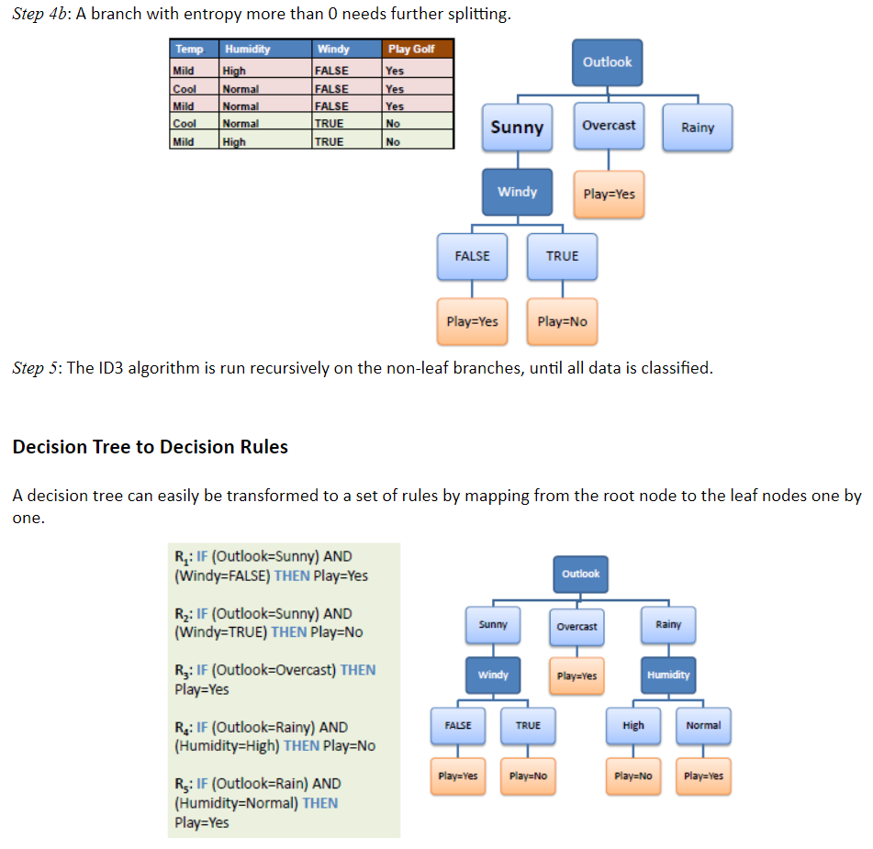

Slide 76
The source of above Information Gain example > https://www.saedsayad.com/decision_tree.htm

